Slide 1
Chapter 8 Chemical Equations

Slide 2
Chemical Reactions
Chemical reactions are processes in which one set of chemicals are converted to a new set of chemicals
Chemical reactions are described by chemical equations.

Slide 3
Evidence for Chemical Reactions
A gas is produced.
A precipitate is formed.
A permanent color change is observed.
An energy change occurs.

Slide 4
Law of Conservation of Mass
In an ordinary chemical reaction, the total mass of reacting substances is equal to the total mass of products formed.

Slide 5
Chemical Equations
N₂ (g) + 3 H₂ (g) → 2 NH₃ (g)
must be balanced to satisfy Law of conservation of mass
State Designations
(g) gas
(l) liquid
(s) solid
(aq) aqueous

Slide 6
Copper(II) oxide reacts with ammonia (NH₃) to yield copper, nitrogen gas, and water.
Write a balanced equation for this reaction.

Slide 7
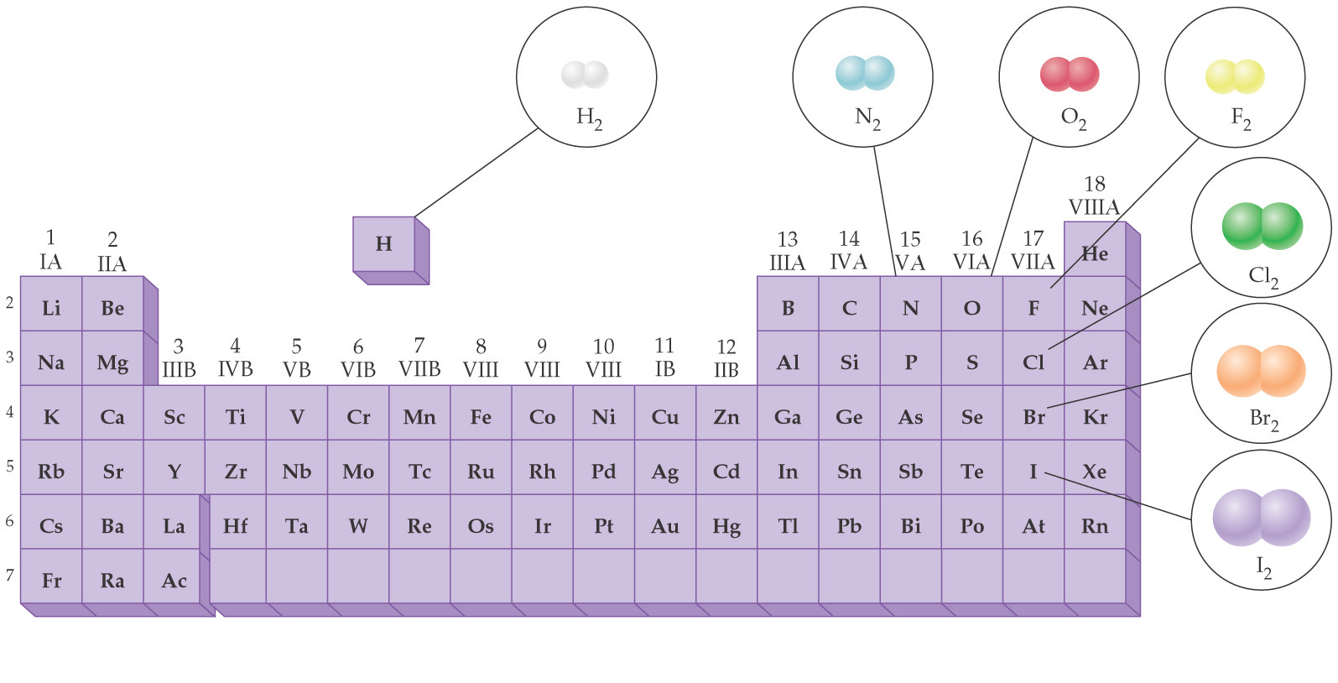
Diatomic Elements

Slide 8
Lead(II) nitrate reacts with potassium chromate to form lead(II) chromate (yellow ppt.) and potassium nitrate.
Hydrochloric acid reacts with sodium carbonate to form carbon dioxide, sodium chloride, and water

Slide 9
Zinc metal reacts with hydrochloric acid to produce zinc chloride and hydrogen gas.
Potassium chlorate when heated, decomposes to form potassium chloride and oxygen gas.

Slide 10
Hexane(C₆H₁₄) burns in oxygen gas to form carbon dioxide and water.
Vinegar(acetic acid) reacts with baking soda (sodium bicarbonate) to produce carbon dioxide gas, sodium acetate, and water.
Ammonia reacts with oxygen gas to form nitrogen monoxide and water.

Slide 11
Iron(III) chloride reacts with ammonium hydroxide to form iron(III) hydroxide (brown ppt.) and ammonium chloride.
Barium hydroxide and ammonium chloride react to form ammonia (NH₃), water, and barium chloride.

Slide 12
Some more examples
N₂ + H₂ ⎯→ NH₃
Be₂C + H₂O ⎯→ Be(OH)₂ + CH₄
HCl + CaCO₃ ⎯→ CaCl₂ + H₂O + CO₂
C₂H₆ + O₂ ⎯→ CO₂ + H₂O

Slide 13
Classifying Reactions by what Atoms Do

Slide 14
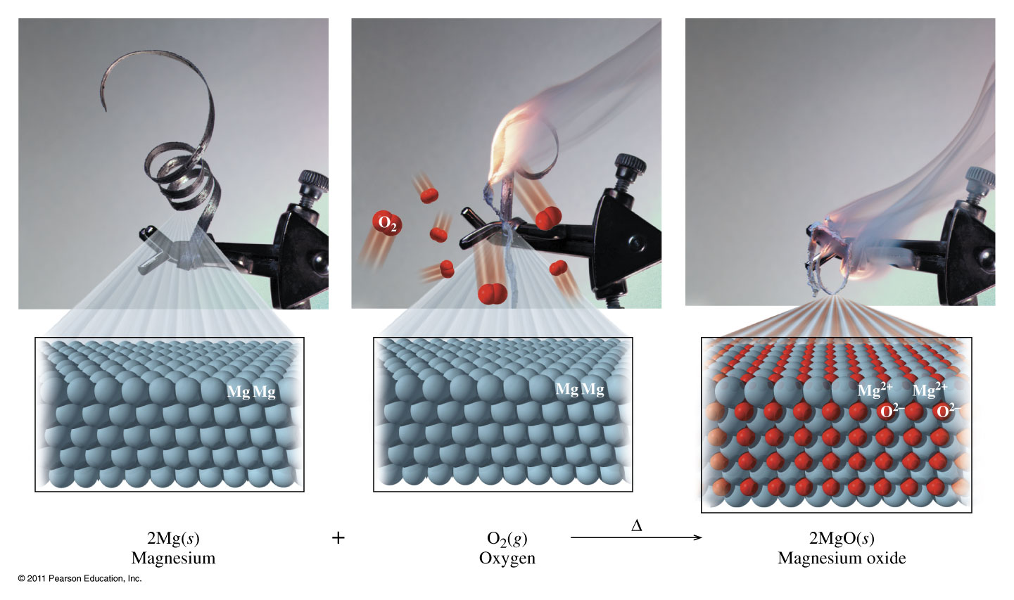
Combination Reaction

Slide 15
Classifying Reactions by what Atoms Do
Combination/Synthesis
A + Z ⎯→ AZ

Slide 16
Decomposition

Slide 17
Classifying Reactions by what Atoms Do
Decomposition
AZ ⎯→ A + Z

Slide 18
Single Replacement

Slide 19
Classifying Reactions by what Atoms Do
Single Displacement
A + BZ ⎯→ AZ + B

Slide 20
Predicting Reactions
Single Displacement
(AKA Single Replacement)

Slide 22
Cu + AgNO₃→

Slide 23
Cr + NiCl₂ →

Slide 24
Cr + Zn(NO₃)₂ →

Slide 25
Zn + HCl →

Slide 26
Fe + HCl →

Slide 27
Double Displacement

Slide 28
Classifying Reactions by what Atoms Do
Double displacement
AX + BZ ⎯→ AZ + BX
Neutralization (special type of double displacement reaction)
HX +BOH ⎯→ BX +H₂O

Slide 29
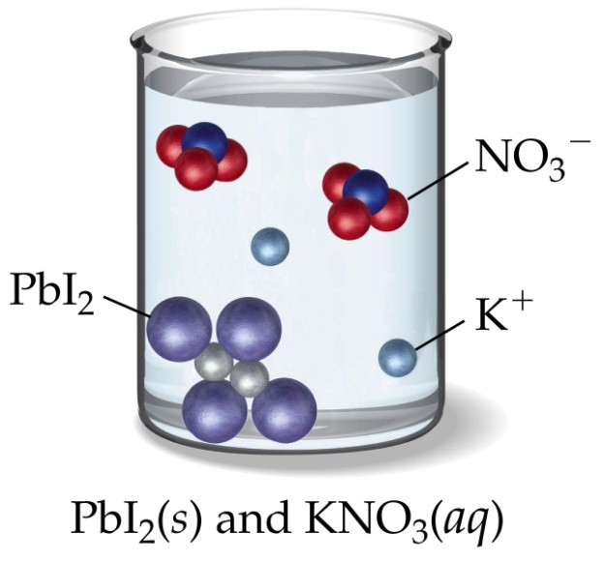
Predicting Reactions Double Displacement

Slide 30
Na₂S + ZnCl₂ →
Na₂S + ZnCl₂ →2 NaCl + ZnS(s)

Slide 31
Mg(NO₃)₂ + NaOH →
Mg(NO₃)₂ + 2 NaOH → Mg(OH)₂(s)+ 2 NaNO₃

Slide 32
AgNO₃ + Na₂SO₄→
AgNO₃ + Na₂SO₄→ NR

Slide 33
K₂CO₃ + HCl →
K₂CO₃ + 2 HCl → (H₂CO₃ + 2 KCl)
→H₂O + CO₂ + 2 KCl

Slide 34
NH₄Cl + KOH →
NH₄Cl + KOH → (NH₄OH + KCl) →
NH₃ +HOH+ KCl

Slide 35
HNO₃ + NaC₂H₃O₂ →
HNO₃(aq) + NaC₂H₃O₂(aq)
→ HC₂H₃O₂(aq) + NaNO₃(aq)

Slide 36
HClO₄ + NaOH →
HClO₄ + NaOH → H₂O(l) + NaClO₄

